Slide 1
PAPER I : DATA MINING UNIT – I INTRODUCTION TO DATA MINING
‹#›
ONLINE / LIVE TEACHING CLASSES
SESSION 2021-2022
DATE: 16 February 2022

Slide 2



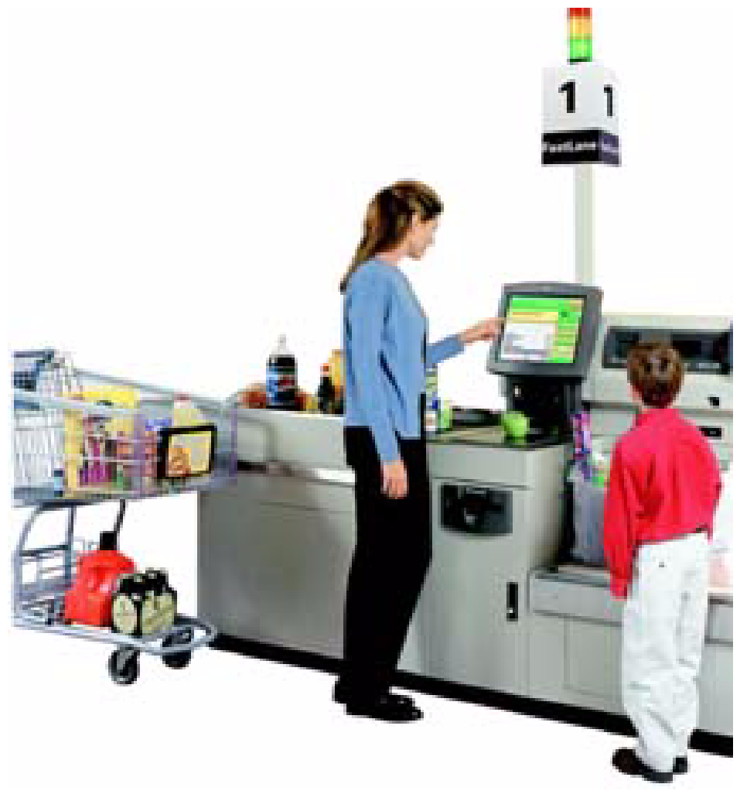
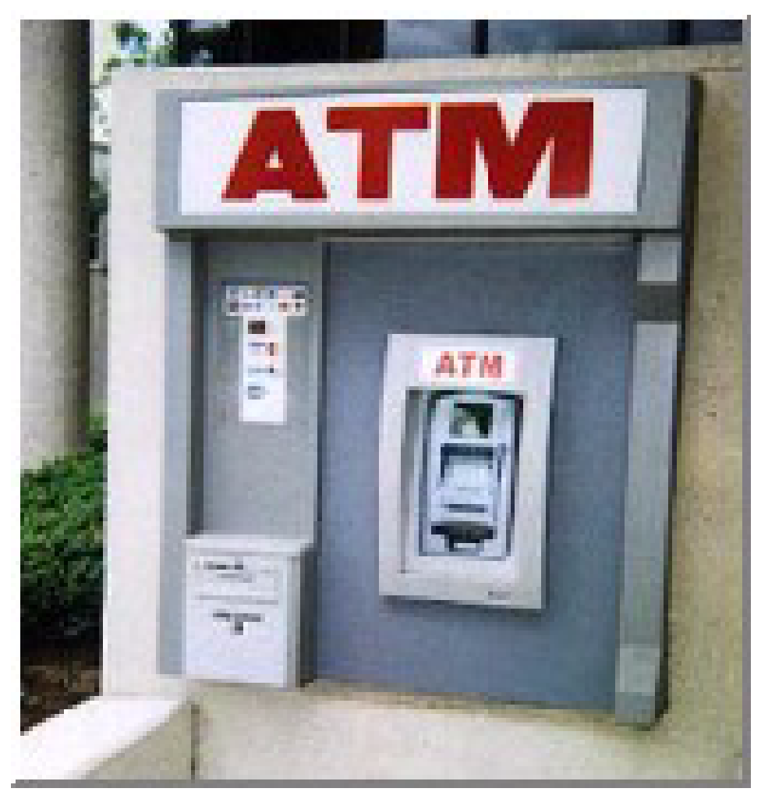
WHY MINE DATA? COMMERCIAL VIEWPOINT
Lots of data is being collected and warehoused
Web data, e-commerce
purchases at department/ grocery stores
Bank/Credit Card transactions
Computers have become cheaper and more powerful
Competitive Pressure is Strong
Provide better, customized services for an edge (e.g. in Customer Relationship Management)

Slide 3
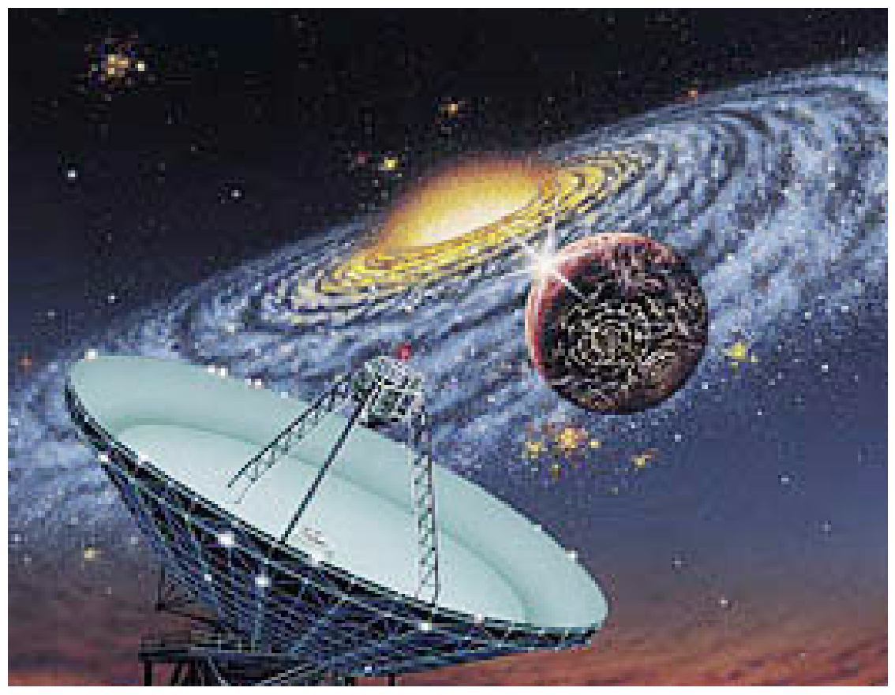
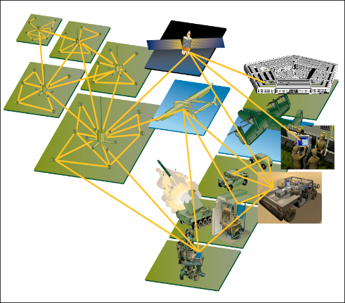
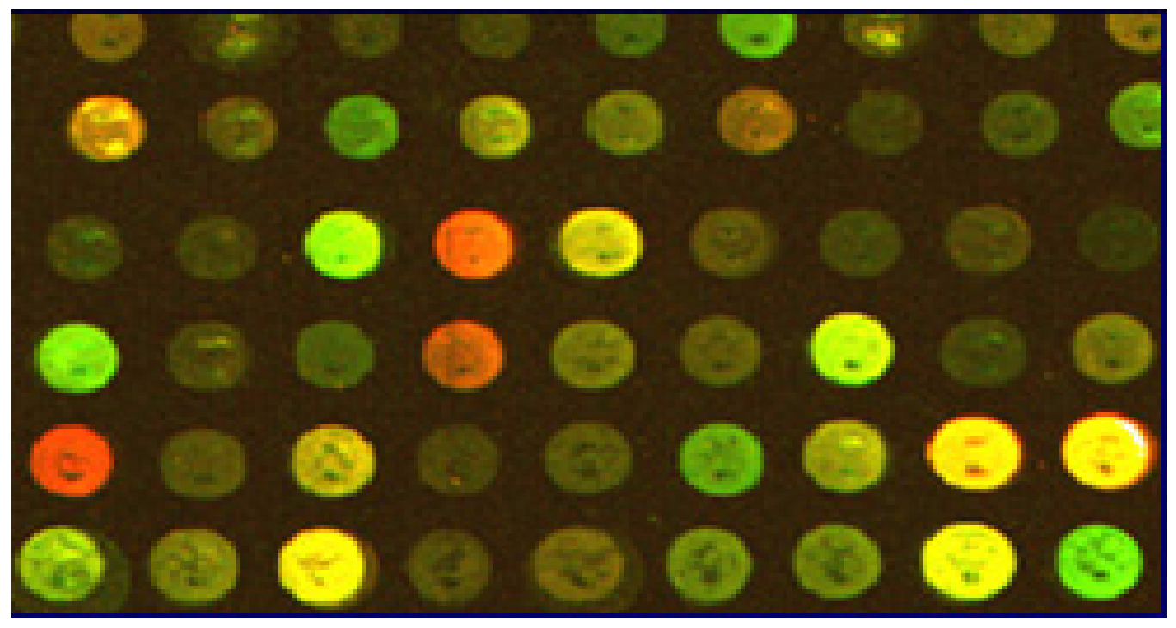
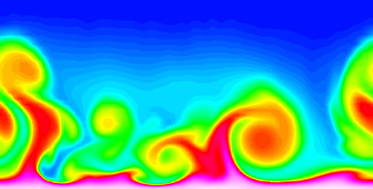
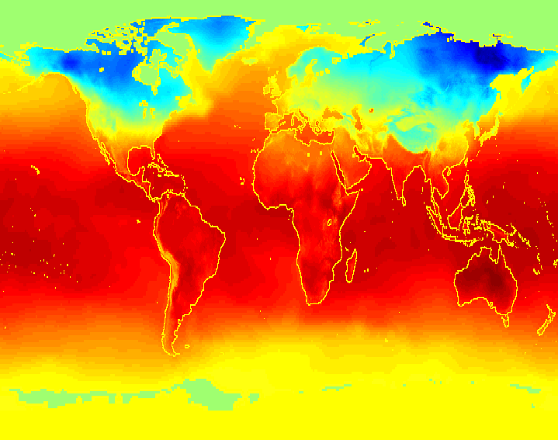
WHY MINE DATA? SCIENTIFIC VIEWPOINT
Data collected and stored at enormous speeds (GB/hour)
remote sensors on a satellite
telescopes scanning the skies
microarrays generating gene expression data
scientific simulations generating terabytes of data
Traditional techniques infeasible for raw data
Data mining may help scientists
in classifying and segmenting data
in Hypothesis Formation

Slide 4
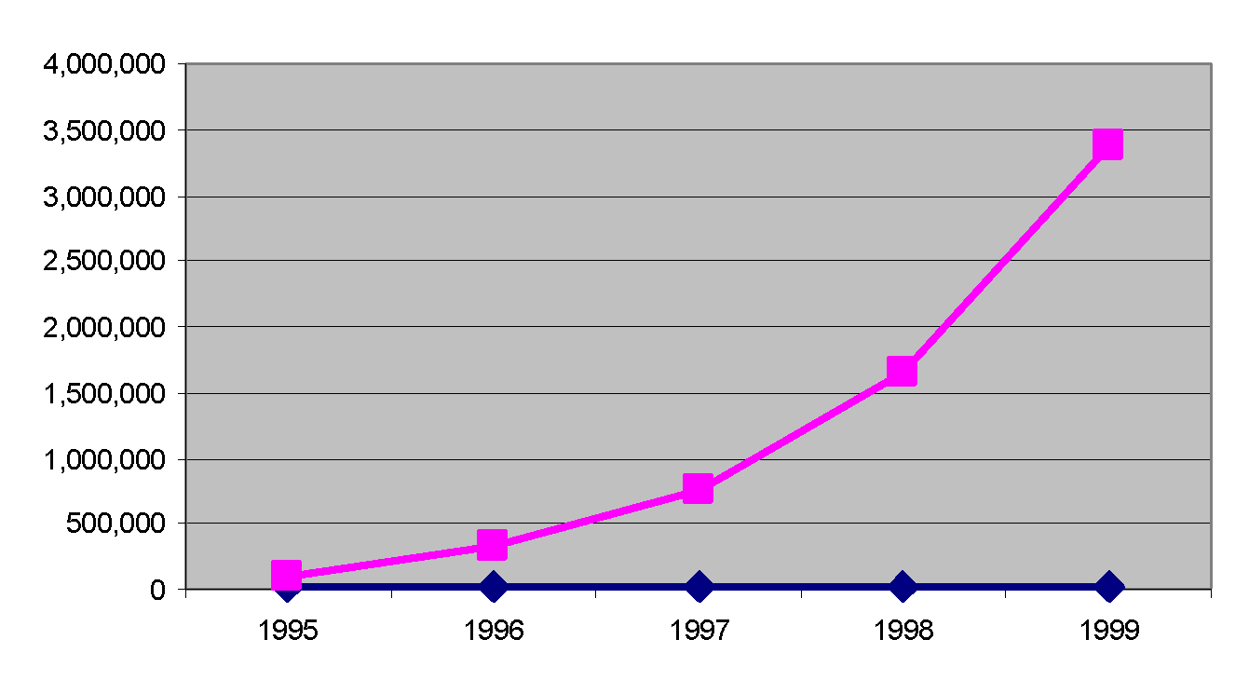
MINING LARGE DATA SETS - MOTIVATION
There is often information “hidden” in the data that is not readily evident
Human analysts may take weeks to discover useful information
Much of the data is never analyzed at all
The Data Gap
Total new disk (TB) since 1995
Number of analysts

Slide 5
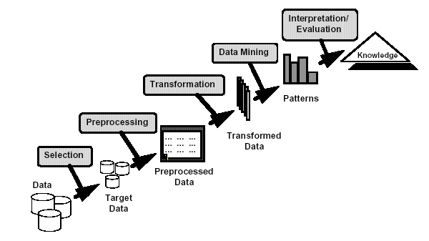
WHAT IS DATA MINING?
Many Definitions
Non-trivial extraction of implicit, previously unknown and potentially useful information from data
Exploration & analysis, by automatic or semi-automatic means, of large quantities of data in order to discover meaningful patterns

Slide 6
WHAT IS (NOT) DATA MINING?
What is not Data Mining?
Look up phone number in phone directory
Query a Web search engine for information about “Amazon”
What is Data Mining?
Certain names are more prevalent in certain US locations (O’Brien, O’Rurke, O’Reilly… in Boston area)
Group together similar documents returned by search engine according to their context (e.g. Amazon rainforest, Amazon.com,)

Slide 7
ORIGINS OF DATA MINING
Draws ideas from machine learning/AI, pattern recognition, statistics, and database systems
Traditional Techniques may be unsuitable due to
Enormity of data
High dimensionality of data
Heterogeneous, distributed nature of data
Statistics/ AI
Machine Learning/
Pattern Recognition
Data Mining
Database systems

Slide 8
DATA MINING TASKS
Prediction Methods
Use some variables to predict unknown or future values of other variables.
Description Methods
Find human-interpretable patterns that describe the data.

Slide 9
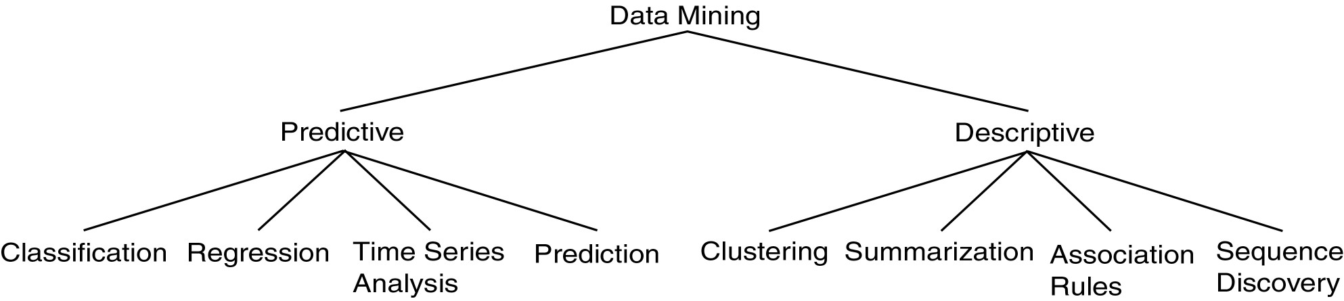
DATA MINING MODELS AND TASKS

Slide 10
DATA MINING TASKS...
Classification [Predictive]
Clustering [Descriptive]
Association Rule Discovery [Descriptive]
Sequential Pattern Discovery [Descriptive]
Regression [Predictive]
Deviation Detection [Predictive]

Slide 11
MARKET BASKET DATA
2 | {Coffee,Sugar,Cookies,Salmon}
3 | {Bread,Butter,Coffee,Diapers,Milk,Eggs}
4 | {Bread,Butter,Salmon,Chicken}
5 | {Eggs,Bread,Butter}
6 | {Salmon,Diapers,Milk}
7 | {Bread,Tea,Sugar,Eggs}
8 | {Coffee,Sugar,Chicken,Eggs}
9 | {Bread,Diapers,Milk,Salt}
10 | {Tea,Eggs,Cookies,Diapers,Milk}
Transaction Id | Items
1 | {Bread,Butter,Dippers,Milk}

Slide 12
CLASSIFICATION: DEFINITION
Given a collection of records (training set )
Each record contains a set of attributes, one of the attributes is the class.
Find a model for class attribute as a function of the values of other attributes.
Goal: previously unseen records should be assigned a class as accurately as possible.
A test set is used to determine the accuracy of the model. Usually, the given data set is divided into training and test sets, with training set used to build the model and test set used to validate it.

Slide 13
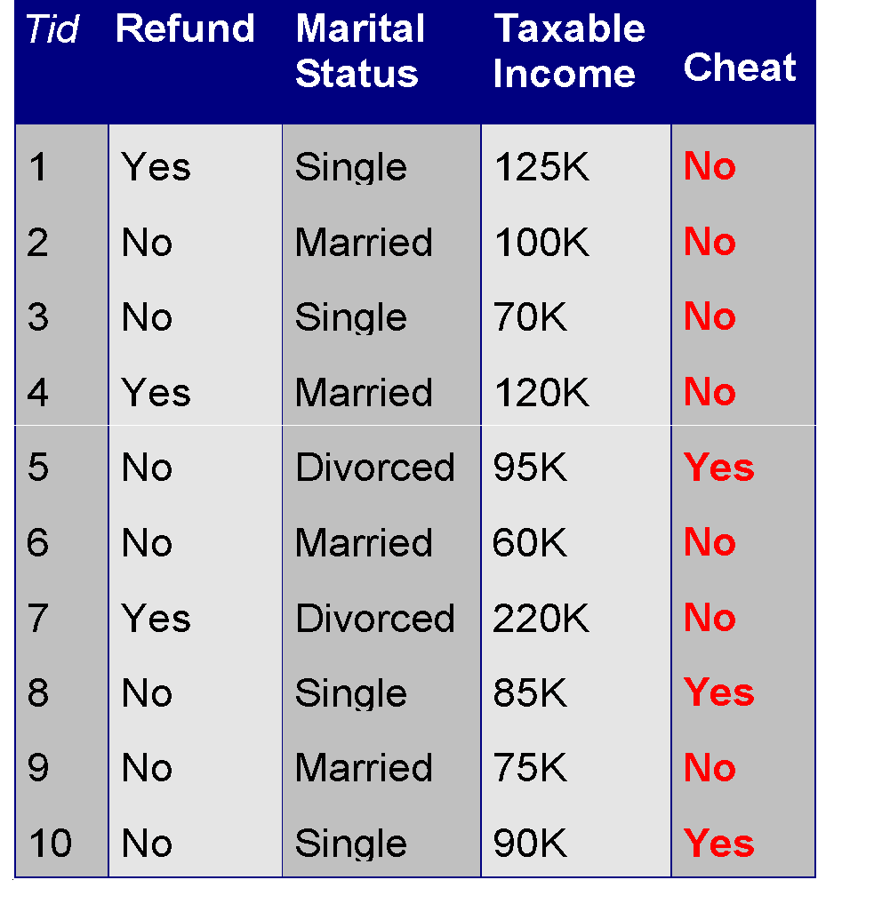
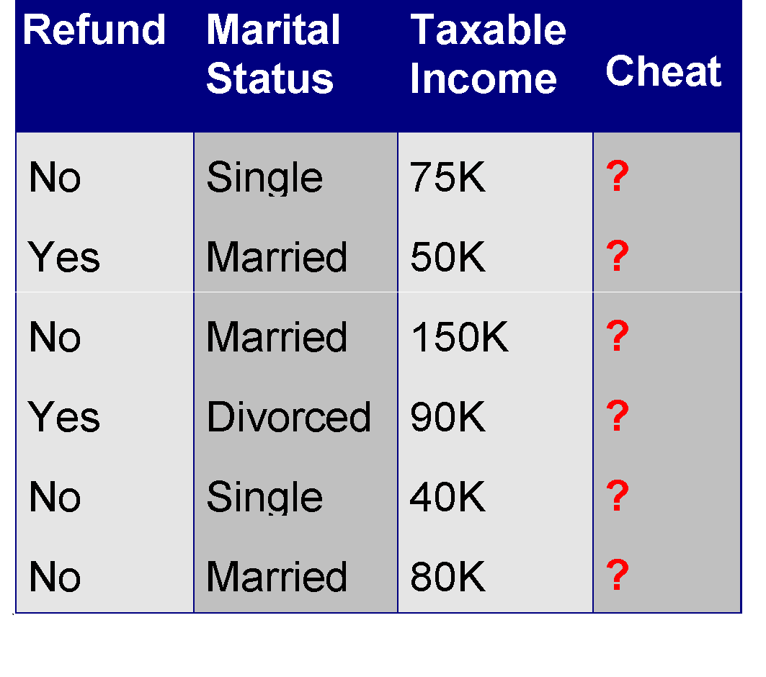
CLASSIFICATION EXAMPLE
categorical
categorical
continuous
class
Test
Set
Learn
Classifier
Training
Set
Model

Slide 14
CLASSIFICATION: APPLICATION 1
Direct Marketing
Goal: Reduce cost of mailing by targeting a set of consumers likely to buy a new cell-phone product.
Approach:
Use the data for a similar product introduced before.
We know which customers decided to buy and which decided otherwise. This {buy, don’t buy} decision forms the class attribute.
Collect various demographic, lifestyle, and company-interaction related information about all such customers.
Type of business, where they stay, how much they earn, etc.
Use this information as input attributes to learn a classifier model.
From [Berry & Linoff] Data Mining Techniques, 1997

Slide 15
CLASSIFICATION: APPLICATION 2
Fraud Detection
Goal: Predict fraudulent cases in credit card transactions.
Approach:
Use credit card transactions and the information on its account-holder as attributes.
When does a customer buy, what does he buy, how often he pays on time, etc
Label past transactions as fraud or fair transactions. This forms the class attribute.
Learn a model for the class of the transactions.
Use this model to detect fraud by observing credit card transactions on an account.

Slide 16
CLASSIFICATION: APPLICATION 3
Customer Attrition/Churn:
Goal: To predict whether a customer is likely to be lost to a competitor.
Approach:
Use detailed record of transactions with each of the past and present customers, to find attributes.
How often the customer calls, where he calls, what time-of-the day he calls most, his financial status, marital status, etc.
Label the customers as loyal or disloyal.
Find a model for loyalty.
From [Berry & Linoff] Data Mining Techniques, 1997

Slide 17
CLASSIFICATION: APPLICATION 4
Sky Survey Cataloging
Goal: To predict class (star or galaxy) of sky objects, especially visually faint ones, based on the telescopic survey images (from Palomar Observatory).
3000 images with 23,040 x 23,040 pixels per image.
Approach:
Segment the image.
Measure image attributes (features) - 40 of them per object.
Model the class based on these features.
Success Story: Could find 16 new high red-shift quasars, some of the farthest objects that are difficult to find!
From [Fayyad, et.al.] Advances in Knowledge Discovery and Data Mining, 1996

Slide 18
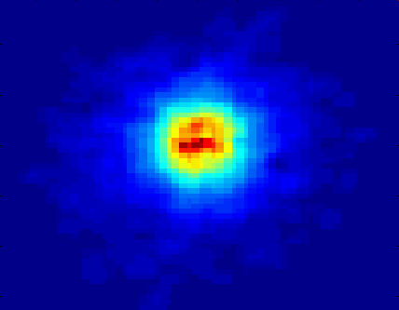
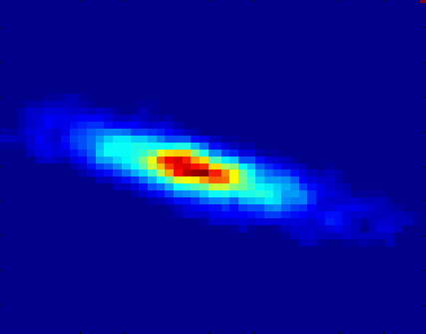
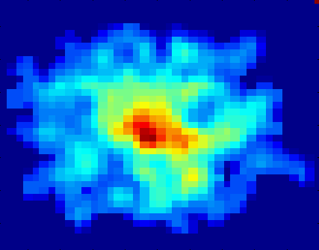
CLASSIFYING GALAXIES
Courtesy: http://aps.umn.edu
Early
Class:
Stages of Formation
Attributes:
Image features,
Characteristics of light waves received, etc.
Intermediate
Late
Data Size:
72 million stars, 20 million galaxies
Object Catalog: 9 GB
Image Database: 150 GB

Slide 19
CLUSTERING DEFINITION
Given a set of data points, each having a set of attributes, and a similarity measure among them, find clusters such that
Data points in one cluster are more similar to one another.
Data points in separate clusters are less similar to one another.
Similarity Measures:
Euclidean Distance if attributes are continuous.
Other Problem-specific Measures.

Slide 20
ILLUSTRATING CLUSTERING
Euclidean Distance Based Clustering in 3-D space.
Intracluster distances
are minimized
Intercluster distances
are maximized

Slide 21
CLUSTERING: APPLICATION 1
Market Segmentation:
Goal: subdivide a market into distinct subsets of customers where any subset may conceivably be selected as a market target to be reached with a distinct marketing mix.
Approach:
Collect different attributes of customers based on their geographical and lifestyle related information.
Find clusters of similar customers.
Measure the clustering quality by observing buying patterns of customers in same cluster vs. those from different clusters.

Slide 22
CLUSTERING: APPLICATION 2
Document Clustering:
Goal: To find groups of documents that are similar to each other based on the important terms appearing in them.
Approach: To identify frequently occurring terms in each document. Form a similarity measure based on the frequencies of different terms. Use it to cluster.
Gain: Information Retrieval can utilize the clusters to relate a new document or search term to clustered documents.

Slide 23
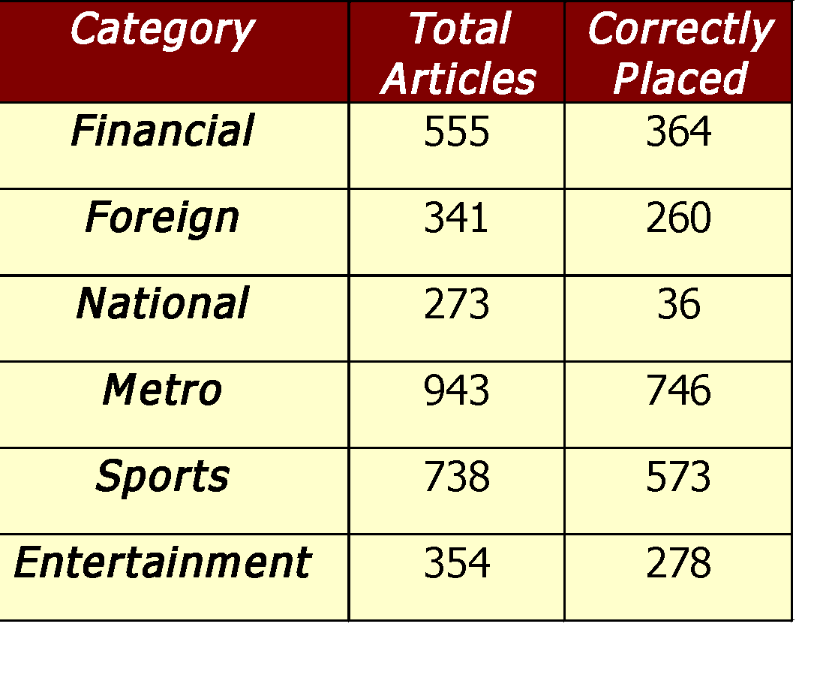
ILLUSTRATING DOCUMENT CLUSTERING
Clustering Points: 3204 Articles of Los Angeles Times.
Similarity Measure: How many words are common in these documents (after some word filtering).

Slide 24
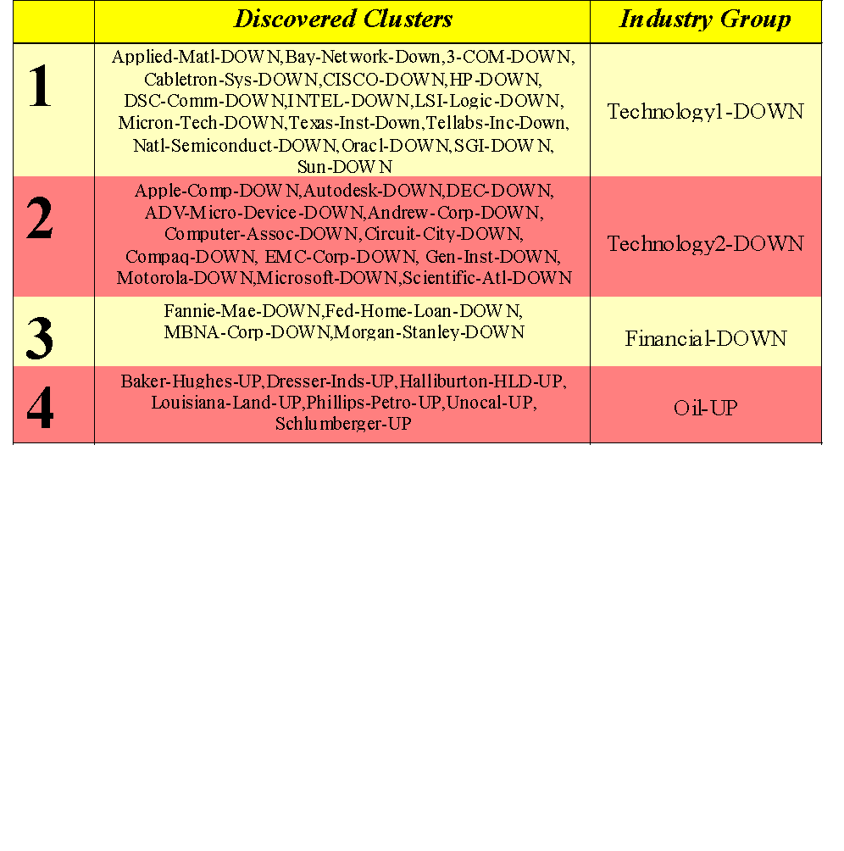
CLUSTERING OF S&P 500 STOCK DATA
Observe Stock Movements every day.
Clustering points: Stock-{UP/DOWN}
Similarity Measure: Two points are more similar if the events described by them frequently happen together on the same day.
We used association rules to quantify a similarity measure.

Slide 25
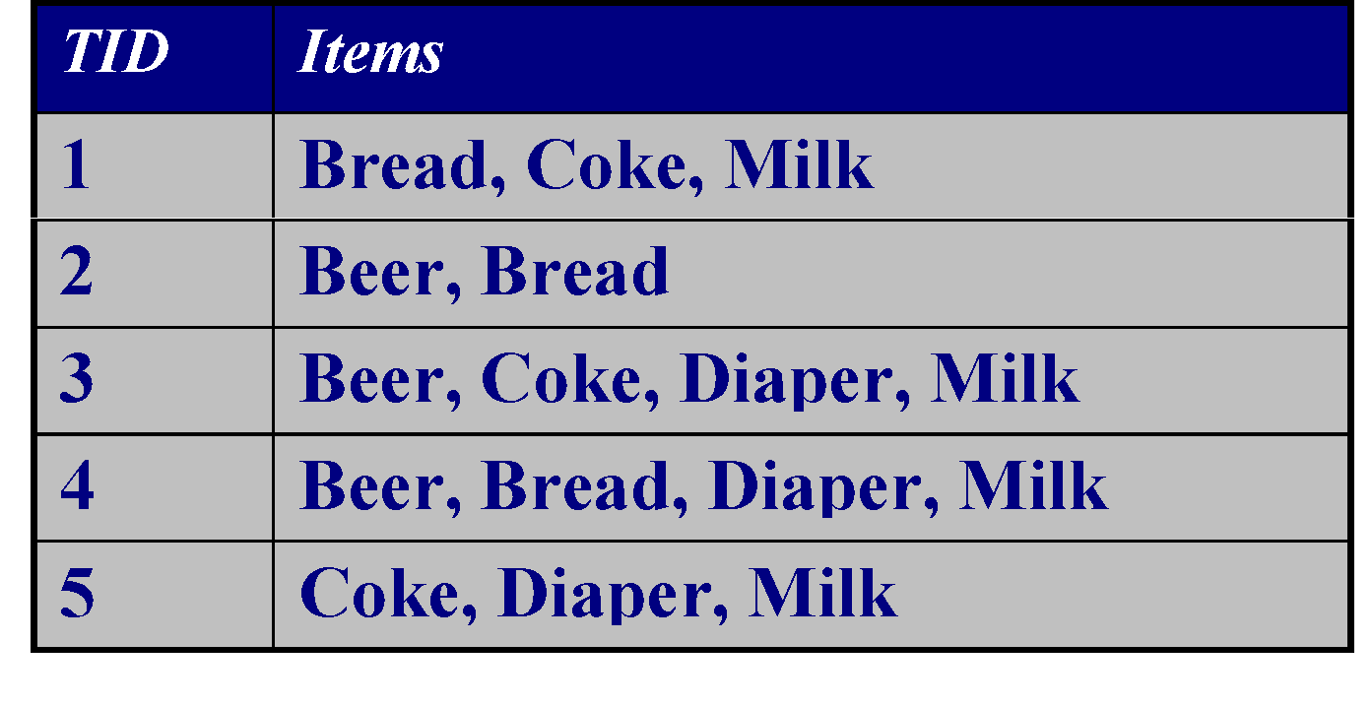
ASSOCIATION RULE DISCOVERY: DEFINITION
Given a set of records each of which contain some number of items from a given collection;
Produce dependency rules which will predict occurrence of an item based on occurrences of other items.
Rules Discovered:
{Milk} --> {Coke}
{Diaper, Milk} --> {Beer}

Slide 26
ASSOCIATION RULE DISCOVERY: APPLICATION 1
Marketing and Sales Promotion:
Let the rule discovered be
{Bagels, … } --> {Potato Chips}
Potato Chips as consequent => Can be used to determine what should be done to boost its sales.
Bagels in the antecedent => Can be used to see which products would be affected if the store discontinues selling bagels.
Bagels in antecedent and Potato chips in consequent => Can be used to see what products should be sold with Bagels to promote sale of Potato chips!

Slide 27
ASSOCIATION RULE DISCOVERY: APPLICATION 2
Supermarket shelf management.
Goal: To identify items that are bought together by sufficiently many customers.
Approach: Process the point-of-sale data collected with barcode scanners to find dependencies among items.
A classic rule --
If a customer buys diaper and milk, then he is very likely to buy beer.
So, don’t be surprised if you find six-packs stacked next to diapers!

Slide 28
ASSOCIATION RULE DISCOVERY: APPLICATION 3
Inventory Management:
Goal: A consumer appliance repair company wants to anticipate the nature of repairs on its consumer products and keep the service vehicles equipped with right parts to reduce on number of visits to consumer households.
Approach: Process the data on tools and parts required in previous repairs at different consumer locations and discover the co-occurrence patterns.

Slide 29
SEQUENTIAL PATTERN DISCOVERY: DEFINITION
Given is a set of objects, with each object associated with its own timeline of events, find rules that predict strong sequential dependencies among different events.
Rules are formed by first disovering patterns. Event occurrences in the patterns are governed by timing constraints.
(A B) (C) (D E)
(A B) (C) (D E)
<= xg
>ng
<= ws
<= ms

Slide 30
SEQUENTIAL PATTERN DISCOVERY: EXAMPLES
In telecommunications alarm logs,
(Inverter_Problem Excessive_Line_Current)
(Rectifier_Alarm) --> (Fire_Alarm)
In point-of-sale transaction sequences,
Computer Bookstore:
(Intro_To_Visual_C) (C++_Primer) --> (Perl_for_dummies,Tcl_Tk)
Athletic Apparel Store:
(Shoes) (Racket, Racketball) --> (Sports_Jacket)

Slide 31
REGRESSION
Predict a value of a given continuous valued variable based on the values of other variables, assuming a linear or nonlinear model of dependency.
Greatly studied in statistics, neural network fields.
Examples:
Predicting sales amounts of new product based on advetising expenditure.
Predicting wind velocities as a function of temperature, humidity, air pressure, etc.
Time series prediction of stock market indices.

Slide 32
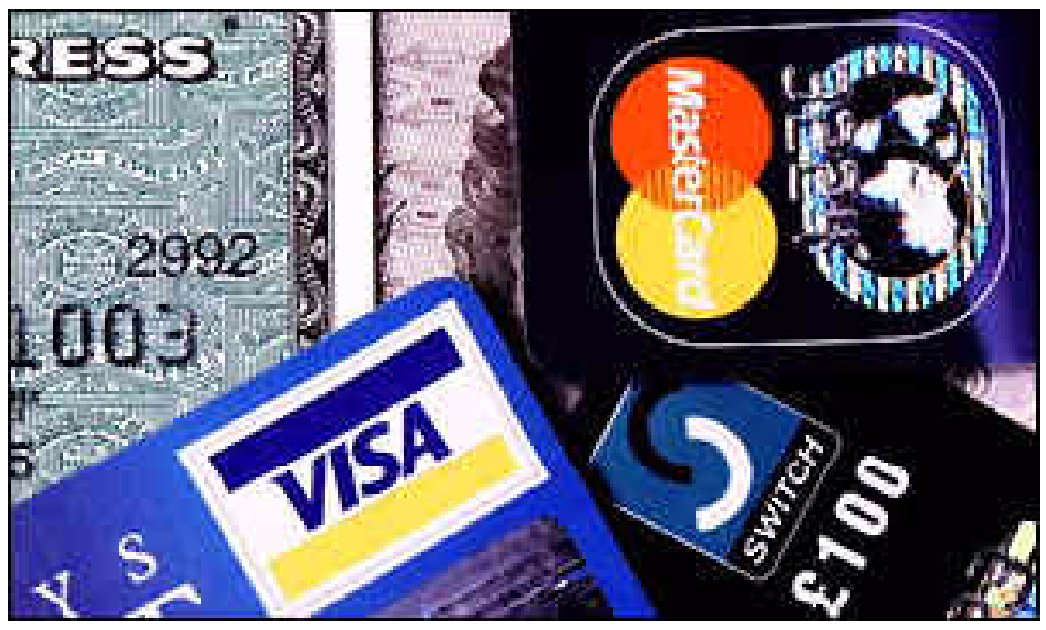
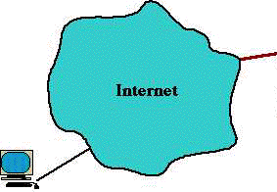
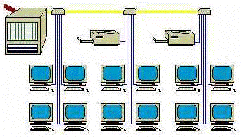

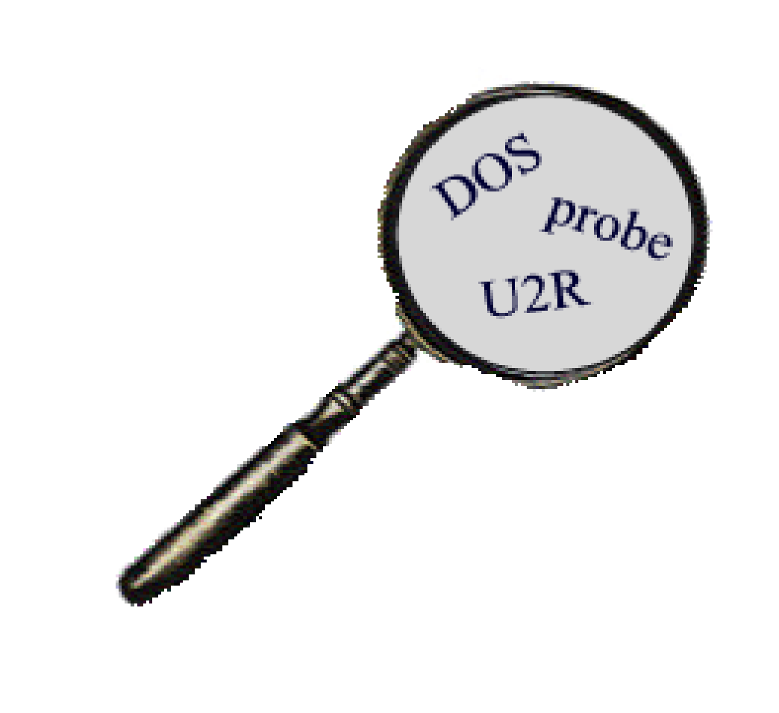
DEVIATION/ANOMALY DETECTION
Detect significant deviations from normal behavior
Applications:
Credit Card Fraud Detection
Network Intrusion Detection
Typical network traffic at University level may reach over 100 million connections per day

Slide 33
CHALLENGES OF DATA MINING
Scalability
Dimensionality
Complex and Heterogeneous Data
Data Quality
Data Ownership and Distribution
Privacy Preservation
Streaming Data

